Slide 1



Slide 2


S3 Performance Optimization
S3 is designed to support very high request rates. However, if your S3 buckets are consistently receiving over 100 PUT/LIST/DELETE or over 300 GET requests per second, then the awesome best practice guidelines that will help optimize S3 performance.
The guidance is based on the type of workload that you are running:
GET-intensive Workloads - Use cloud front Content delivery service to get the best performance. Cloud front cache your most frequently access objects and it will significantly reduce latency for your GET requests.

Slide 3
S3 Performance Optimization
Mixed Request Type Workload: a mix of GET/PUT/DELETE/GET Bucket - the key names that you use for your objects can really impact performance intensive workload.
S3 uses key names to determine which physical partition an object is going to be stored in.
The use of sequential key names Ex: names that are prefixed with a time stamp or an alphabetical sequence increases the likelihood of having multiple objects stored within the same partition.
For heavy workloads this can cause issues I/O contention because you're trying to access
files that are physically located within the same partition.
By using a random prefix to key names instead of a sequential one you could actually
force S3 to distribute your keys across multiple partitions thus distributing the I/O workload.

Slide 4
S3 Performance Optimization
Mixed Request Type Workload: a mix of GET/PUT/DELETE/GET Bucket - the key names that you use for your objects can really impact performance intensive workload.
S3 uses key names to determine which physical partition an object is going to be stored in.
The use of sequential key names Ex: names that are prefixed with a time stamp or an alphabetical sequence increases the likelihood of having multiple objects stored within the same partition.
For heavy workloads this can cause issues I/O contention because you're trying to access
files that are physically located within the same partition.
By using a random prefix to key names instead of a sequential one you could actually
force S3 to distribute your keys across multiple partitions thus distributing the I/O workload.

Slide 5
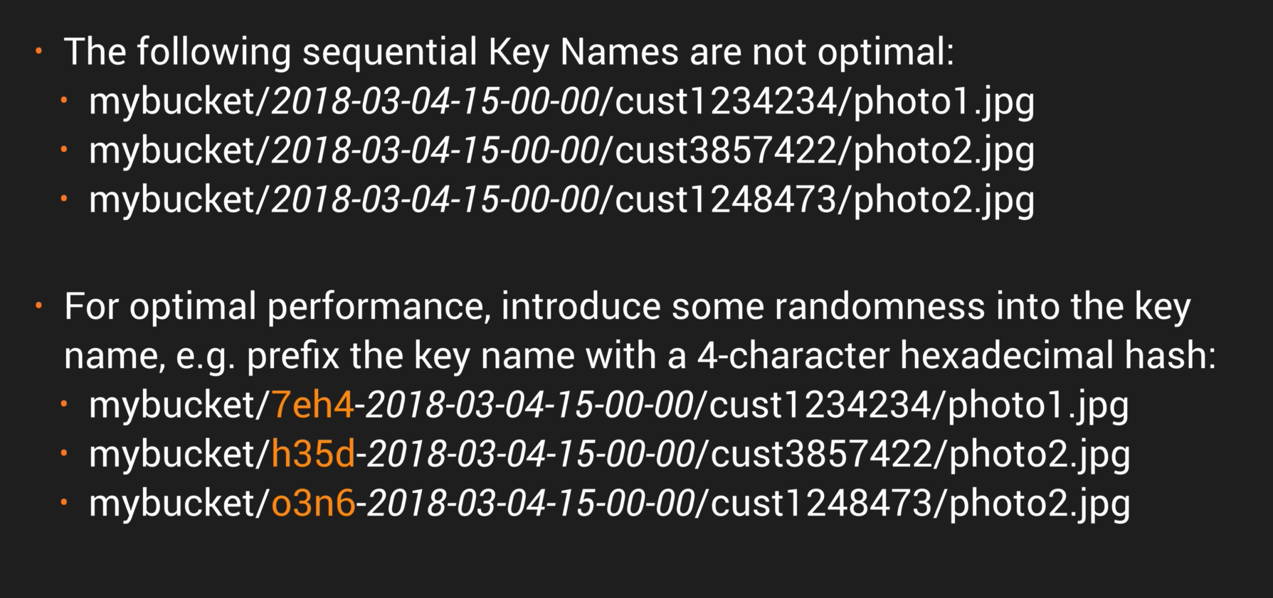
S3 Key Name Example

Slide 6
S3 Performance Optimization- Update
In July 2018, Amazon announce a massive increase in S3 performance.
3500 PUT requests per second
5500 get requests
This new increased performance negate the previous guidance to randomize your object key names to achieve faster performance
This means logical and sequential naming pattern can now be used without any performance implication

Slide 7
S3 Performance Optimization – Exam tips
Remember the 2 main approaches to Performance Optimization for S3:
GET-intensive Workloads : Use cloud front Content
Mixed Request Type Workload : Avoid sequential key names for S-3 objects. Instead use a random prefix like a hex hash at the front of the key name to prevent multiple objects from being stored on the same partition.

Slide 8
Thank you

